Slide 1
Warm Homes – What we can do to keep heat in, moisture at bay and have good air quality

Slide 2
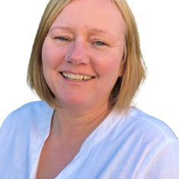
Introduction
Ann Vanner
Prestonian
Lancastrian
Human
Fellow of the Chartered Institute of Architectural Technologists
Regenerative Practitioner
Living Future Accredited Professional

Slide 3
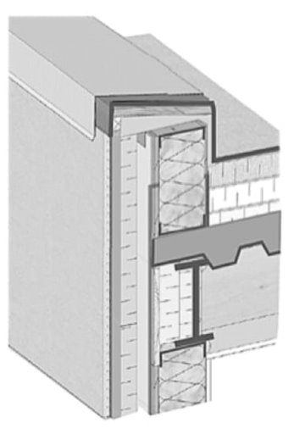
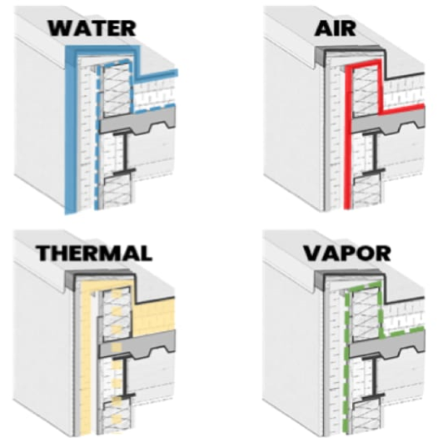
Introduction to architectural technology
‘Changing the world one detail at a time’

Slide 4
What to expect in the next 30 mins or so
I am going to go through some slides
There will be a few unfamiliar words and introduction to a few theories and ideas
Please don’t panic.
Don’t need you to do anything, other than breathe.

Slide 5
What is the problem?
By the time you are 80 you will have spent 72 years of life indoors
POINT 01 – The climate crises and homes
Over the last 30 years we have seen a Green Building Movement.
Tackling energy, waste and water
However, as we are reducing buildings heat loss and heating demand, by insulation the walls, floors and installing better windows and doors, lets also make sure that we are improving the indoor air quality and ensure good and appropriate ventilation, access to light and nature.
Ann Vanner FCIAT, LFA, ARB, RIBA, FRSA

Slide 6
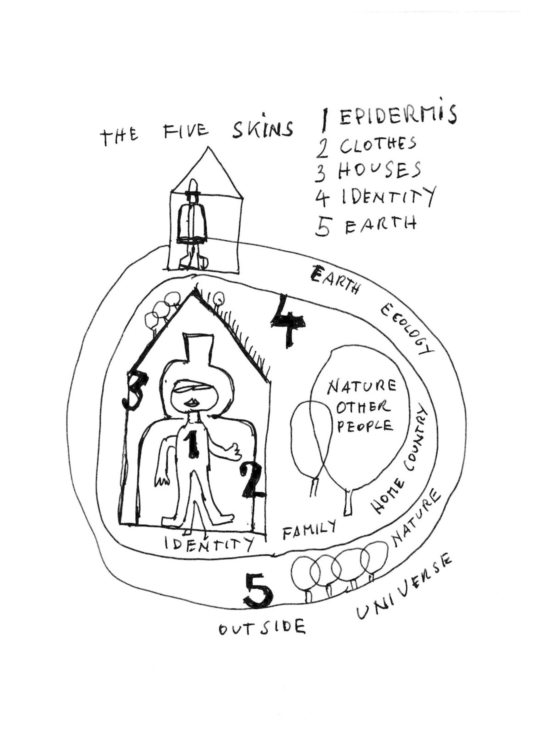
It’s a big problem!
The recent pandemic threw into sharp focus the relationship between housing and health (which cost the NHS about £2.5 billion a year)
POINT 02 – Health. Our health and our buildings health.
40% of any nation's healthcare costs are directly attributed to its build environment, (Source M. Brown Future Restorative 2016)
We need to see a HEALTHY BUILDING MOVEMENT
We talk about our health and the health of our buildings.
They can be seen as two separate parts or as one thing
Your home is our third skin – your first which is your flesh, your second are your clothes, and the building the third
Enclosing, protecting and regulating conditions for your comfort.
Drawing by Hundertwasser 1982
Ann Vanner FCIAT, LFA, ARB, RIBA, FRSA

Slide 7
We don’t blame the plant when it's not thriving – We move it!
Health is made at home; hospitals are for repairs
POINT 03 – Health (again)
We should be focusing on factors that support health and wellbeing, rather then on factors that reduce illness.
Health is fundamental to our lives
We should however not just aim to survive, but to thrive.
As the skin provides additional protection its important to build healthy homes to promote the occupants well being.
Ann Vanner FCIAT, LFA, ARB, RIBA, FRSA

Slide 8
The importance of the Home
Ann Vanner FCIAT, LFA, ARB, RIBA, FRSA

Slide 9
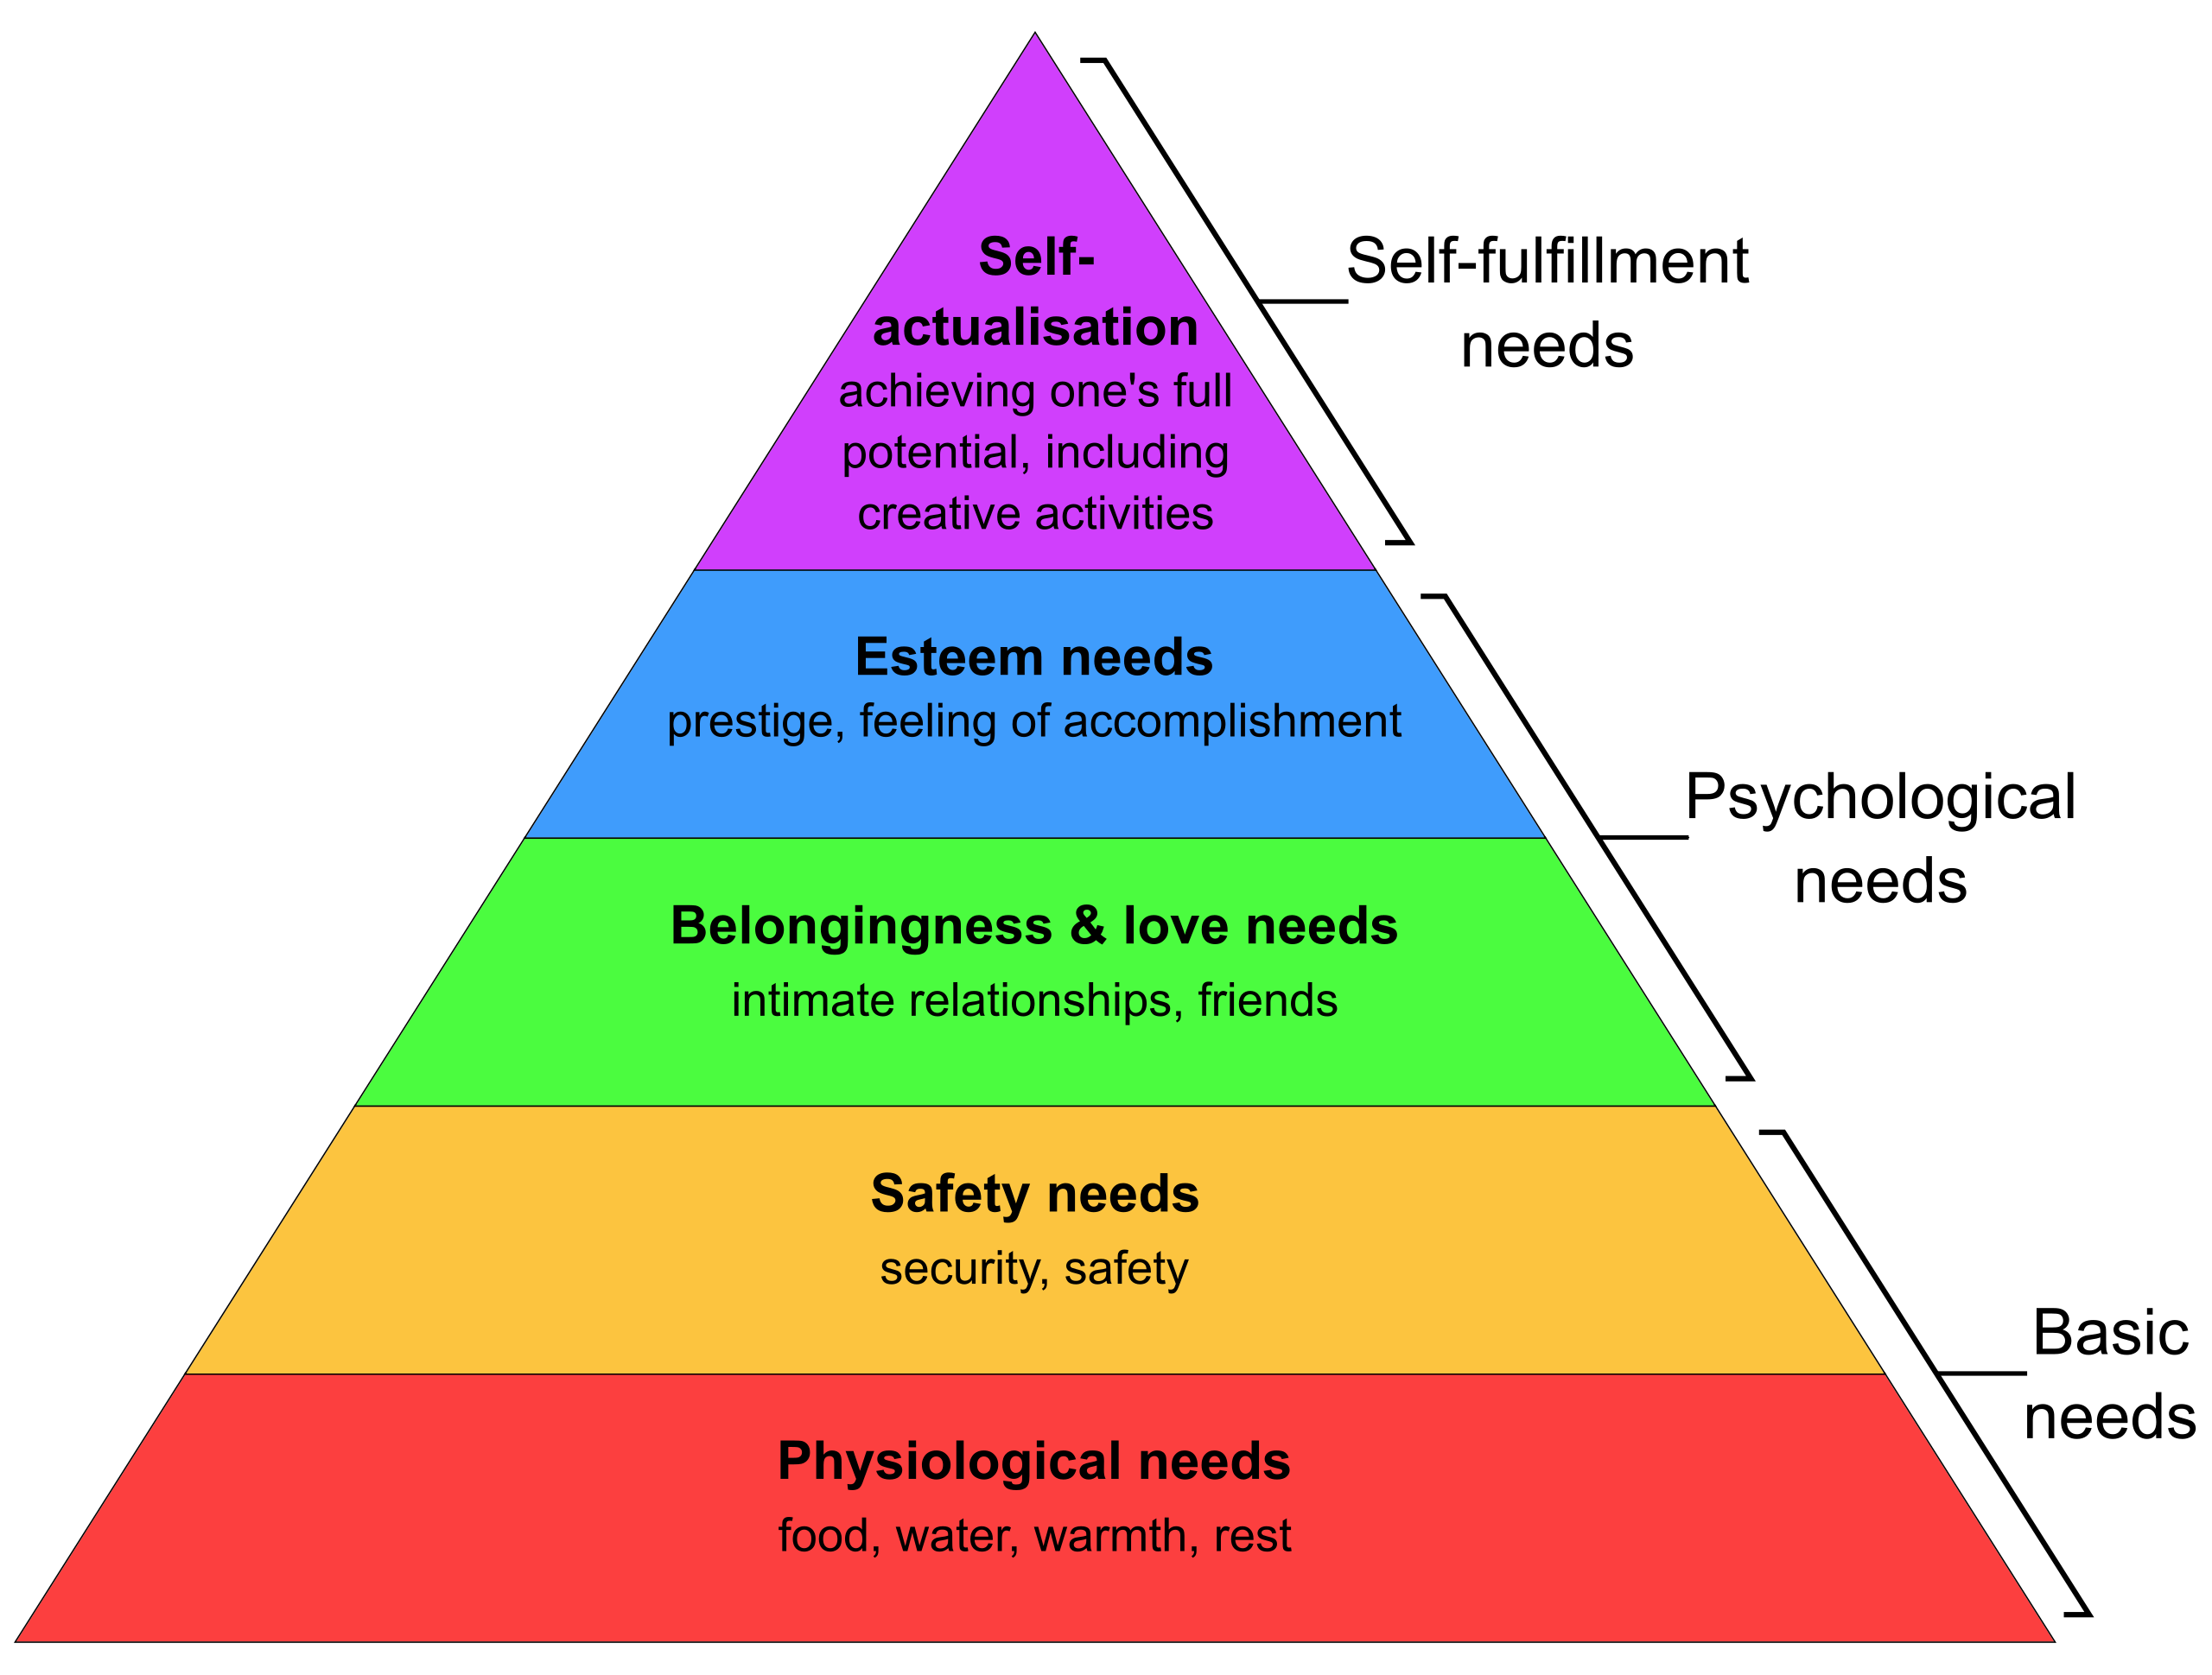
Why specifically homes?
If we are fortunate enough, we choose where to live.
It's often our biggest asset.
It's supposed to meet all our needs during our lifetime.
Its where we spend most of our time.
Other buildings we use on a daily basis are managed and maintained for us.
Maslow's Hierarchy of Needs.

Slide 10
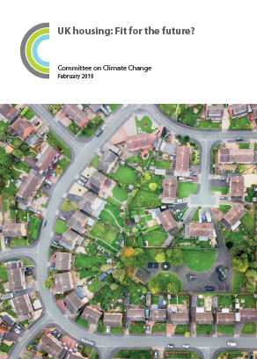
About our housing stock.
The UK housing stock is the oldest in Europe (and some of the coldest).
Almost all existing homes we have now, will remain in use.
80% of the homes we will be living in by 2050 are already built.
New homes are built at a rate of 1% of the existing housing stock.

Slide 11
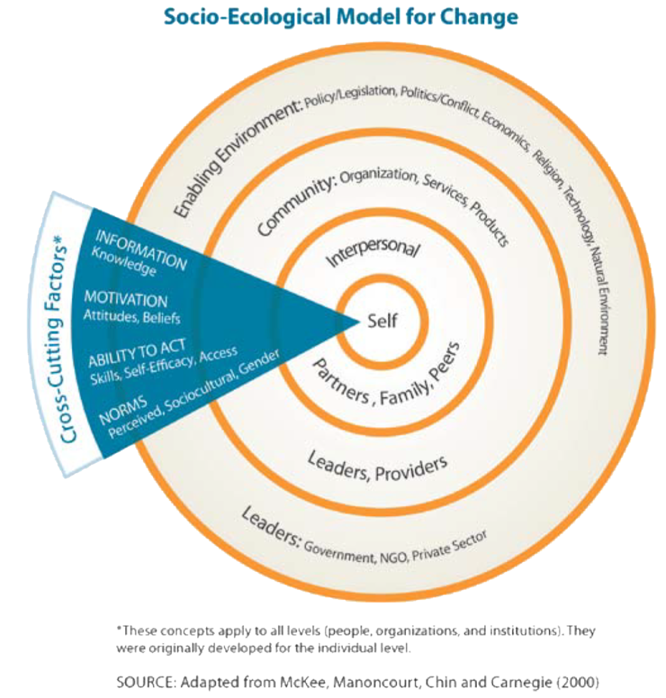
How we use our homes
Bear in mind 62% of changes necessary for the UK to reach net zero are behavioural and societal changes
Technology is not what is holding us back

Slide 12
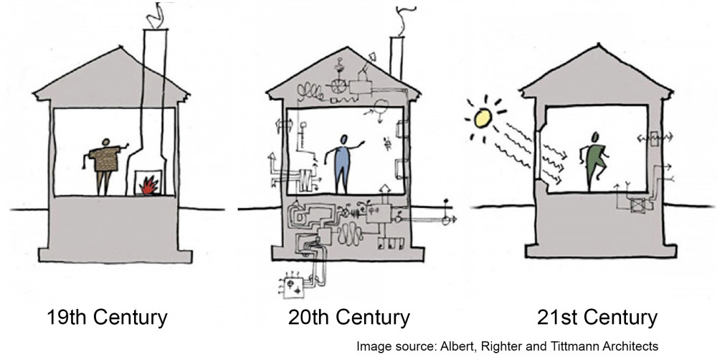
How we should use our homes

Slide 13
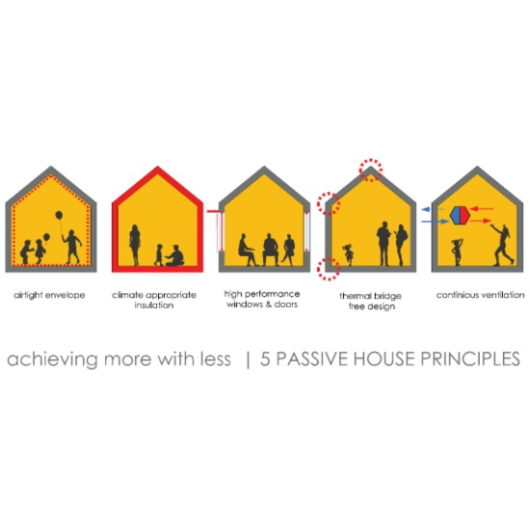
How we should design our homes

Slide 14
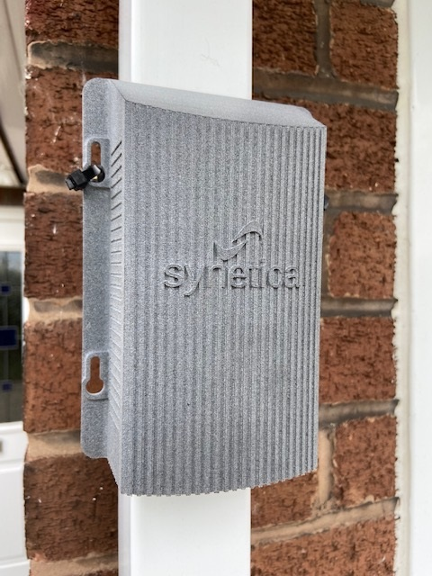
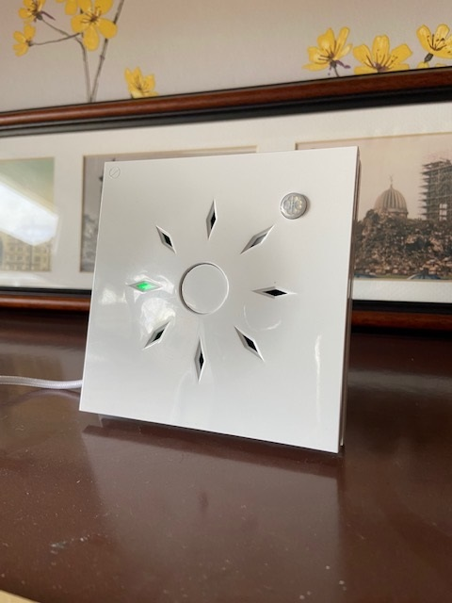
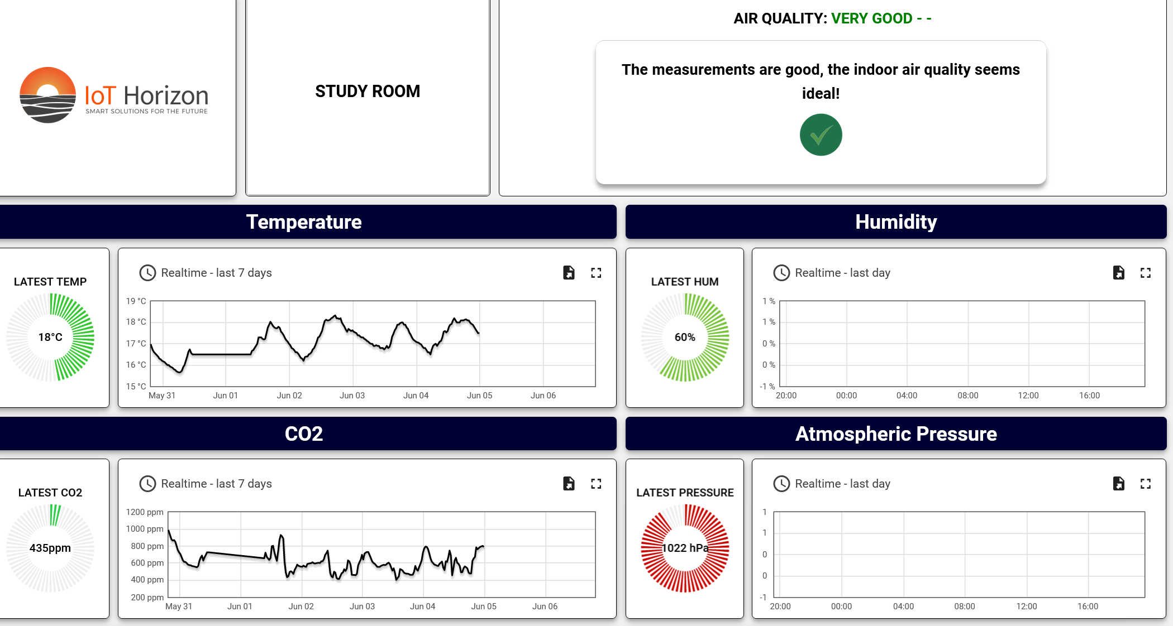
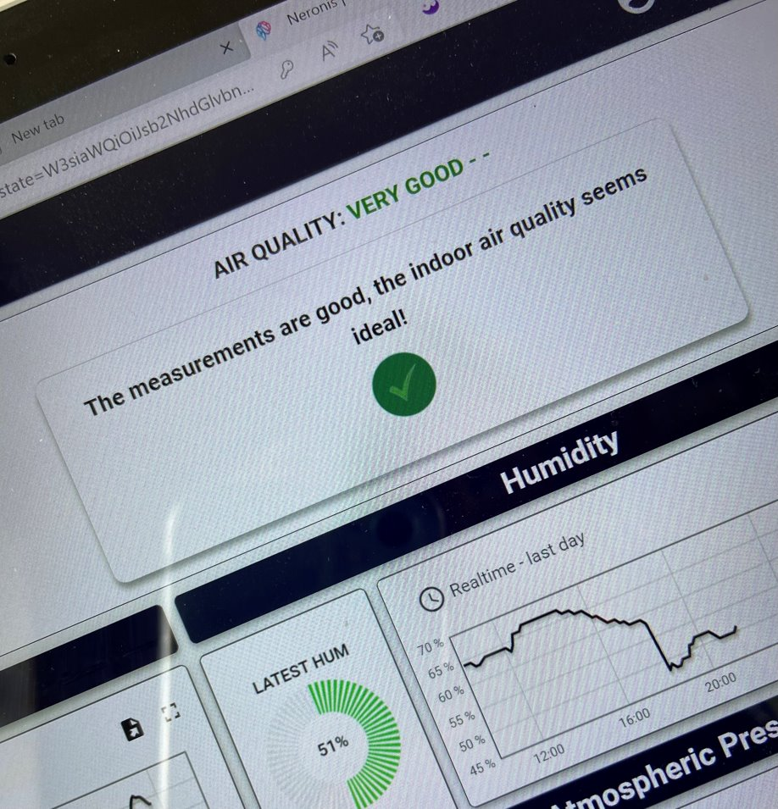
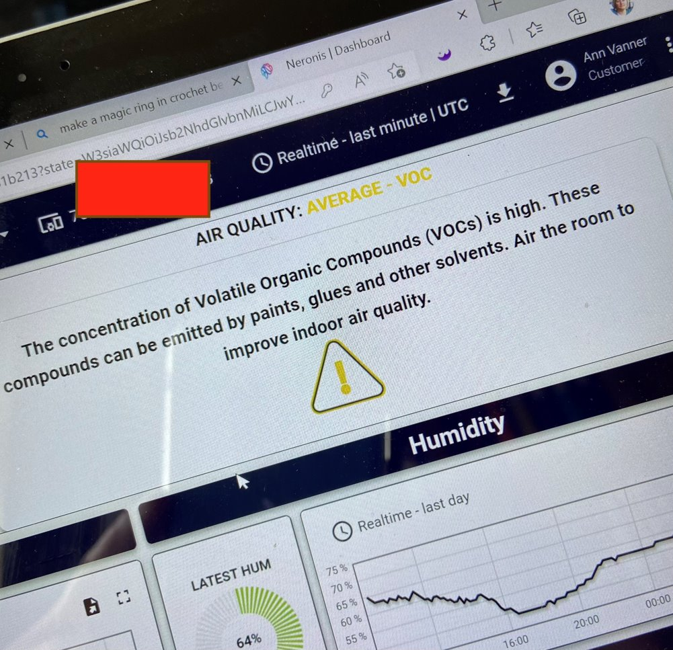
We are going to focus on environmental issues – (the indoor environment)
Thermal comfort (how hot and cold it is), air quality, ventilation, day light and acoustic issues.
These factors are all interrelated but are all able to be monitored and measured.
Which is what I did at my home!

Slide 15
The importance of indoor air quality

Slide 16
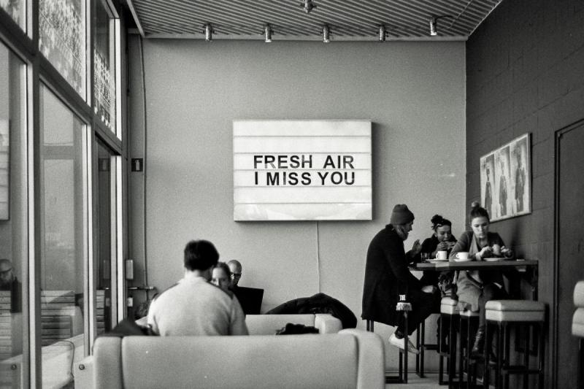
What do I mean by ‘air quality’ / ‘air pollution’?
Gases, particles and liquids
And why is it important ?
These toxic substances can get into our bodies.
Breathing – via the lungs
Dermal Contact – Absorption via skin and mucous membranes
Food and water – oral ingestion and digestive system

Slide 17
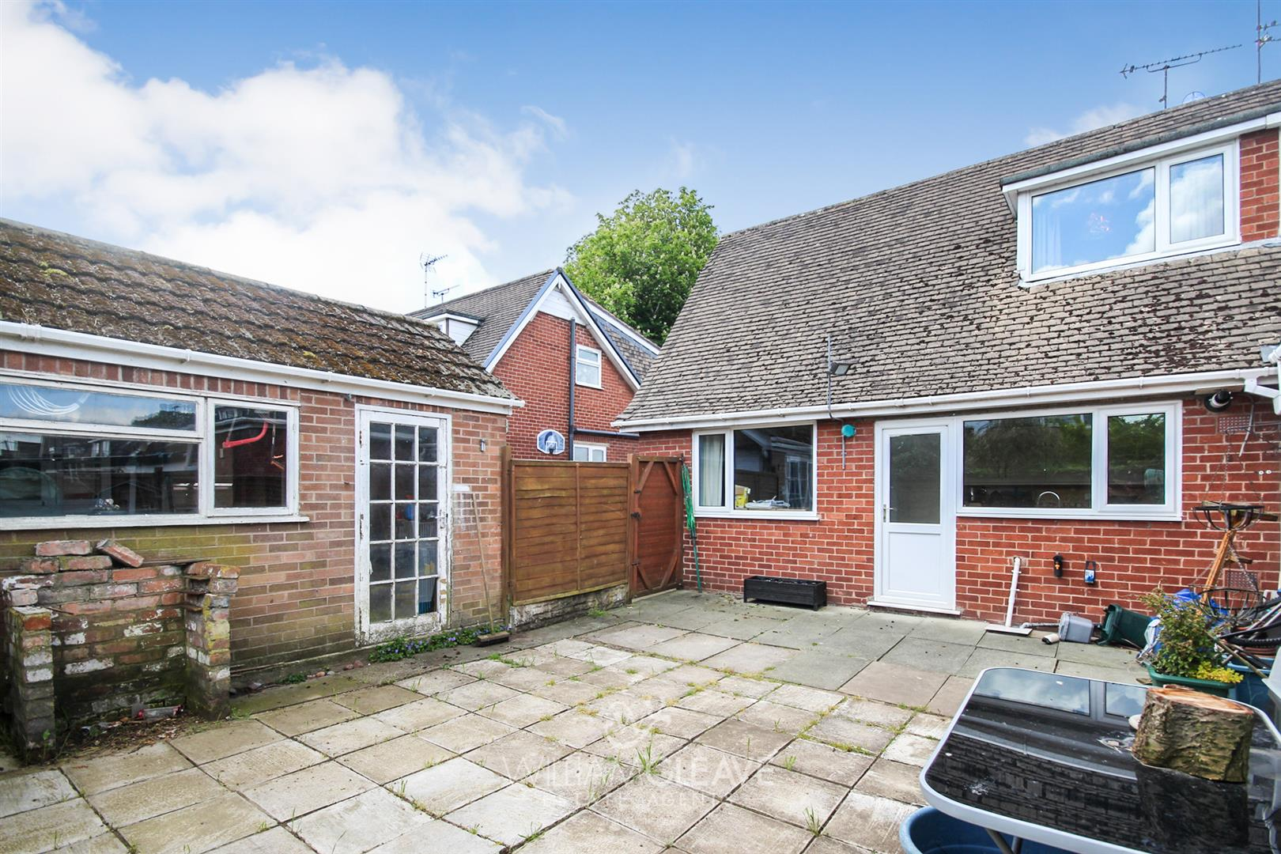
Lets take a walk around a typical home here in the northwest and look at some of the issues.
What and where are the issues?

Slide 18
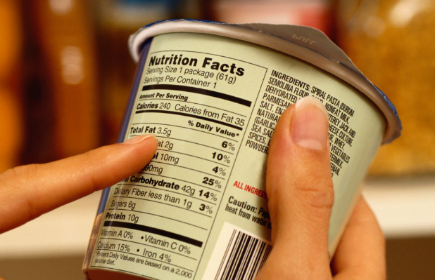
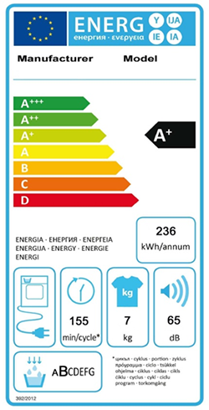
But before we do, just think…..where are the labels of ingredients for a house?
Ann Vanner FCIAT, LFA, ARB, RIBA, FRSA

Slide 19
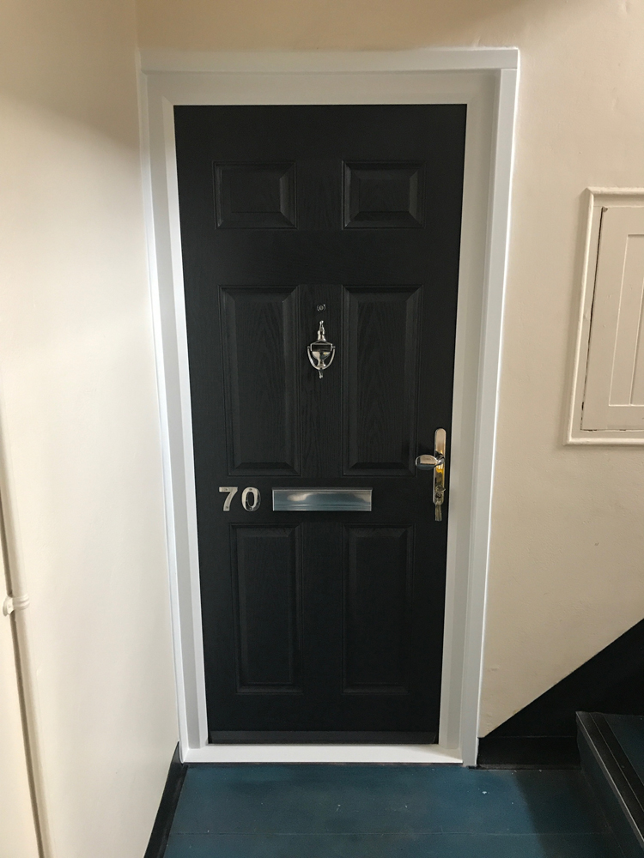
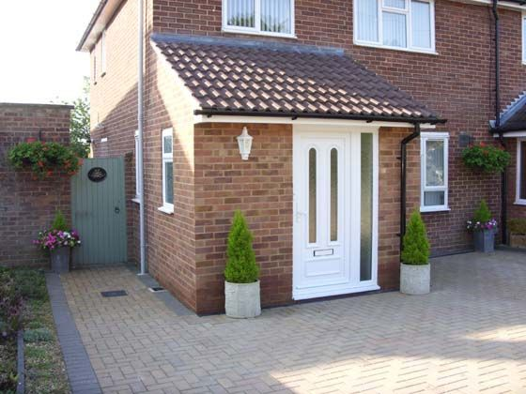
The front door/main entrance
Outside air quality. Loss of heat – where are the porches/lobbies?
Doors and sources of pollution.
Answer- Curtains, draught extuders, letter box on the outside of the house

Slide 20
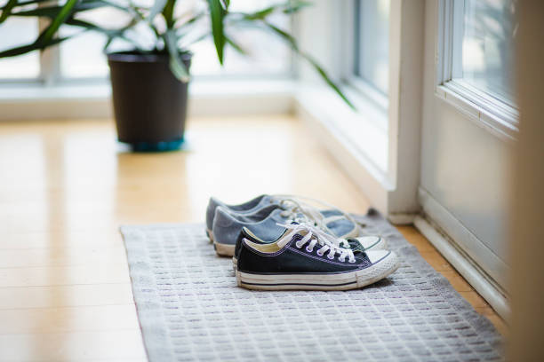
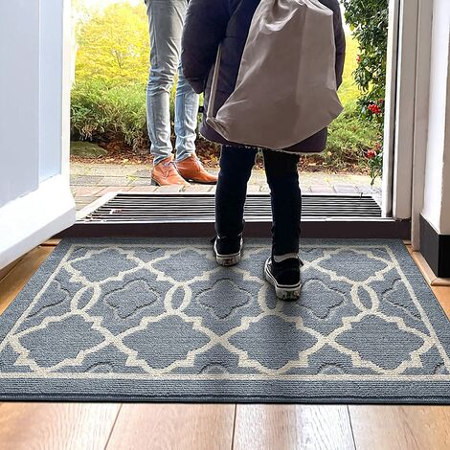
The porch/hallway
Good places to catch the dirt from shoes etc. Being designed out of homes. Where to leave your coat and shoes? To leave damp coats. Change into warm inside clothes

Slide 21
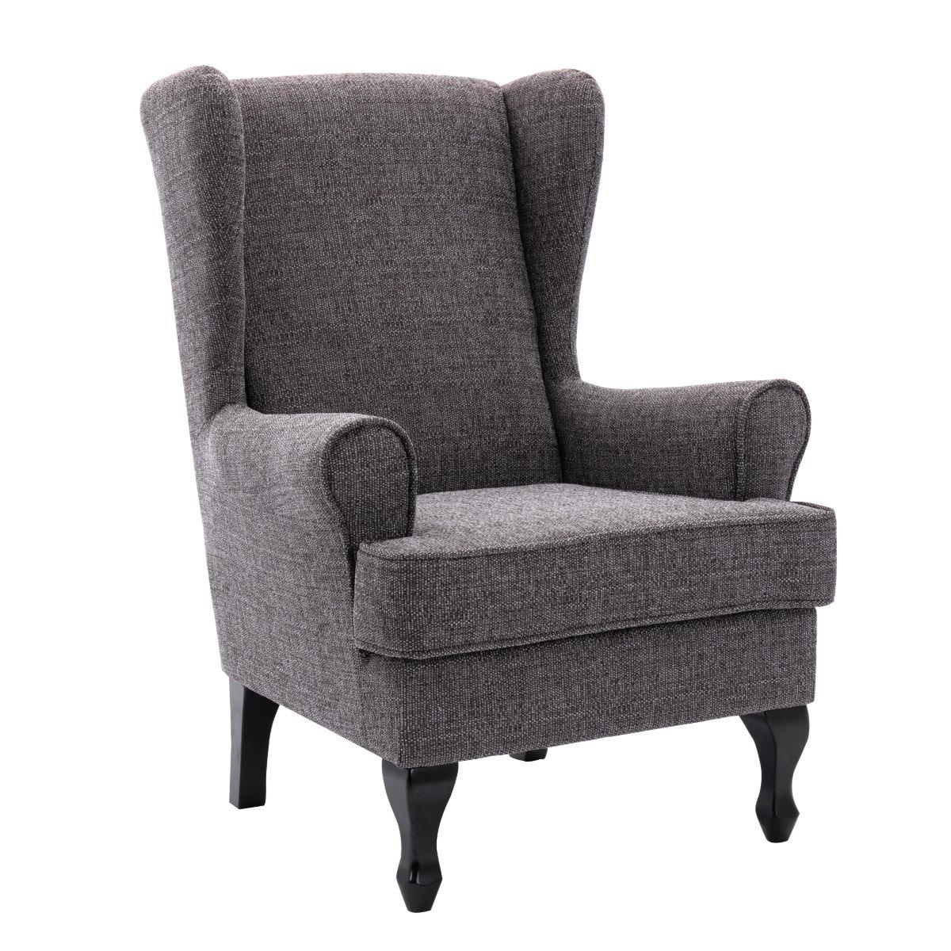
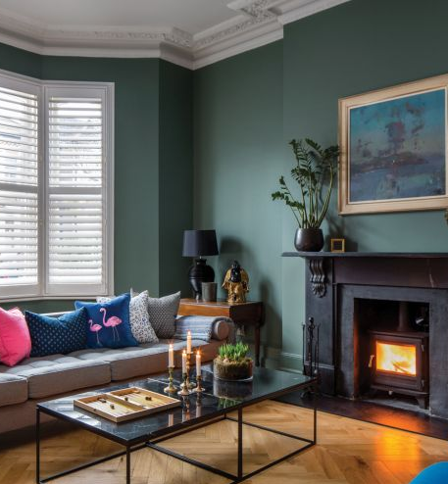
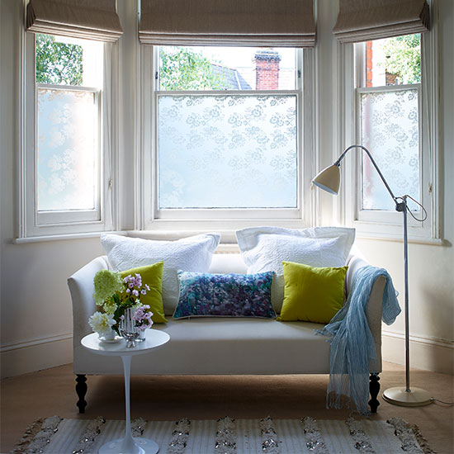
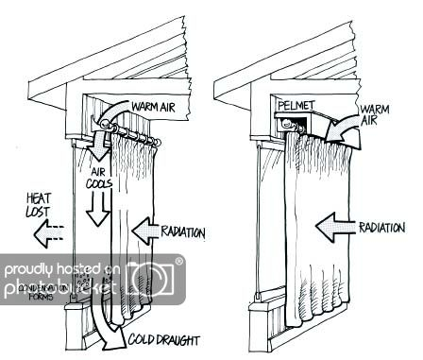
The sitting room/living room/front room/lounge
Carpets and soft furnishings. Curtains, blinds, but remember we need to get to the windows

Slide 22
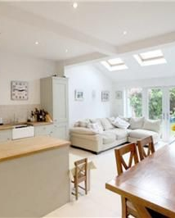
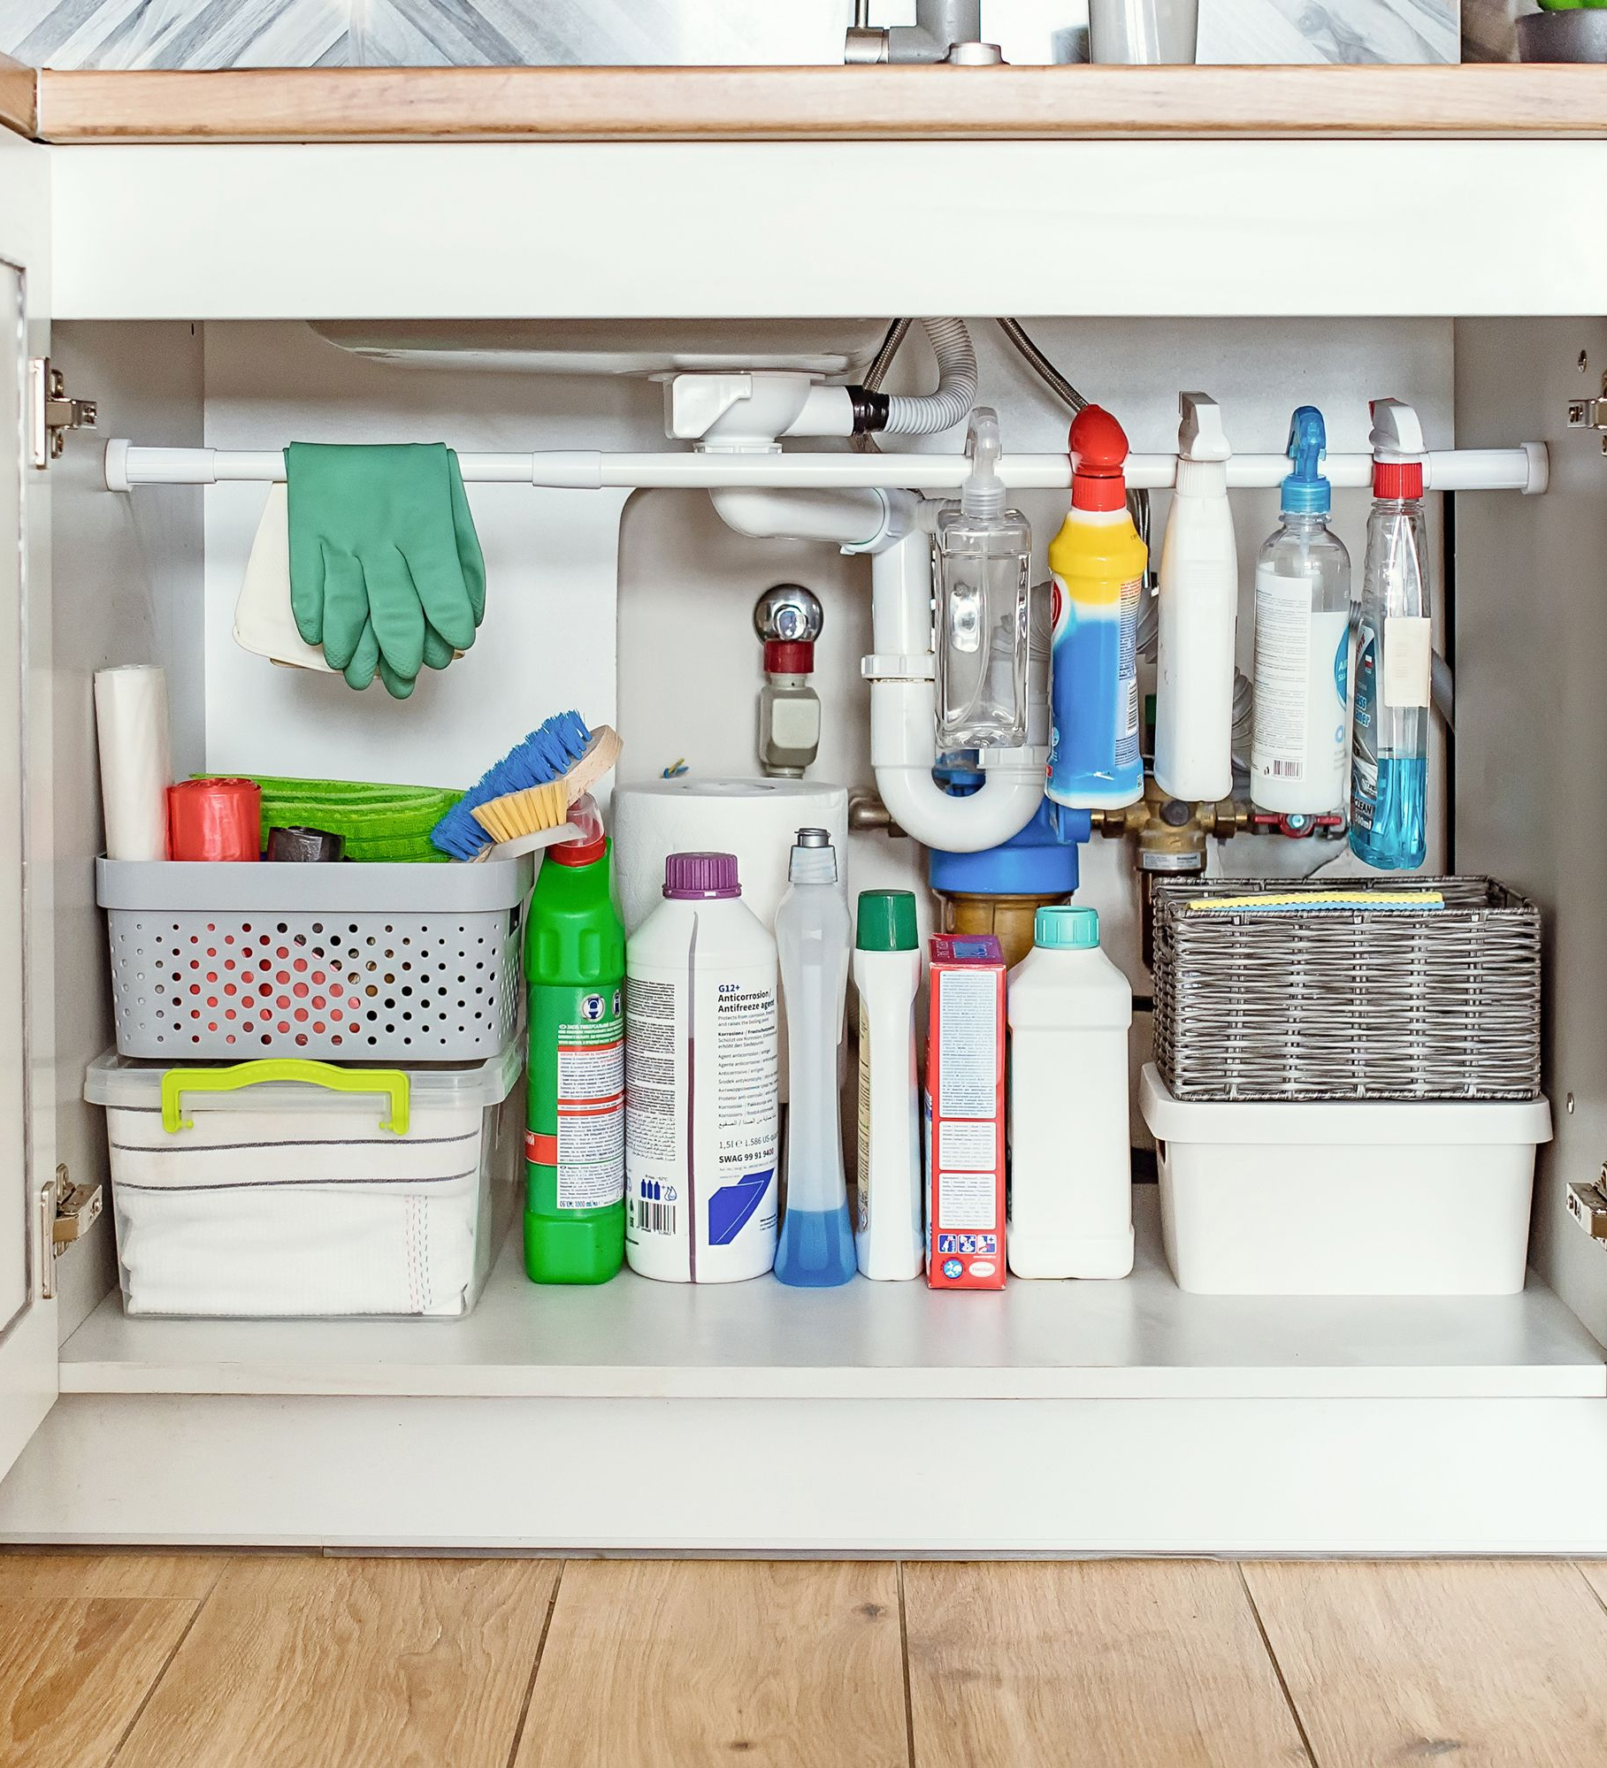
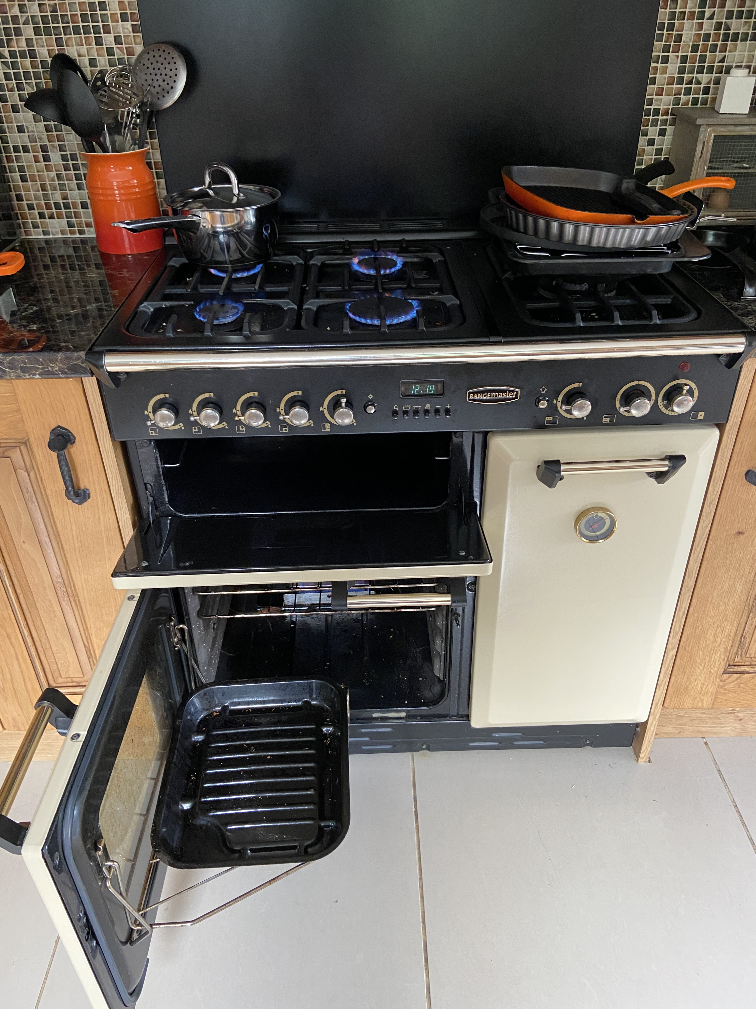
The kitchen
Access to windows. Desire for open plan – lack of control between spaces. Chemicals to clean surfaces. Impact of cooking. Cleaning filters in extractors. Ability to ventilate – remove moisture from the air.

Slide 23
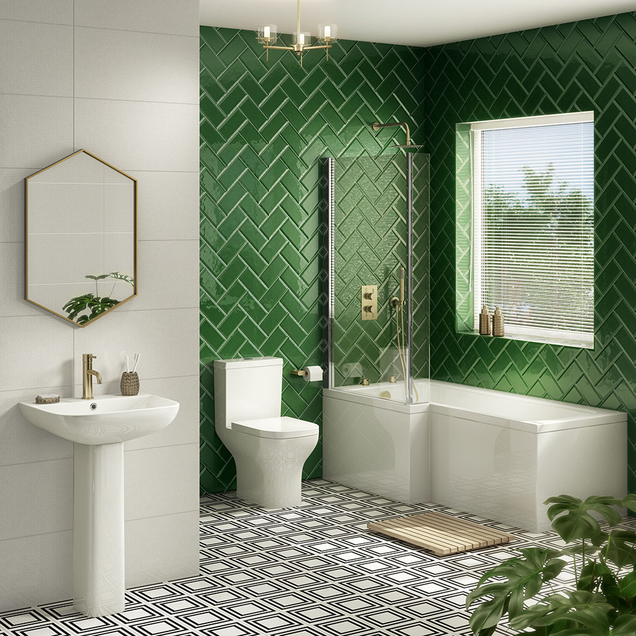
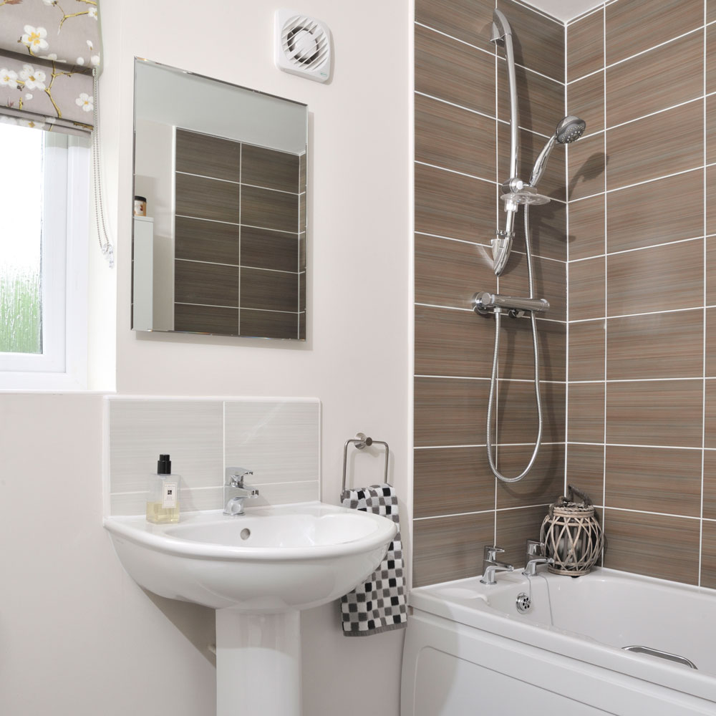
The bathroom
They really need good ventilation. Humid moist air. Rooms without windows. Difficult to access those windows that are there. The impact of ‘chemical cocktail effect’

Slide 24
The bedroom
Not airing your bedroom before going to bed. Issue of windows access. Noise pollution. Should be a place to reduce stress. Quiet / restorative space to recover from the sensory overload.

Slide 25
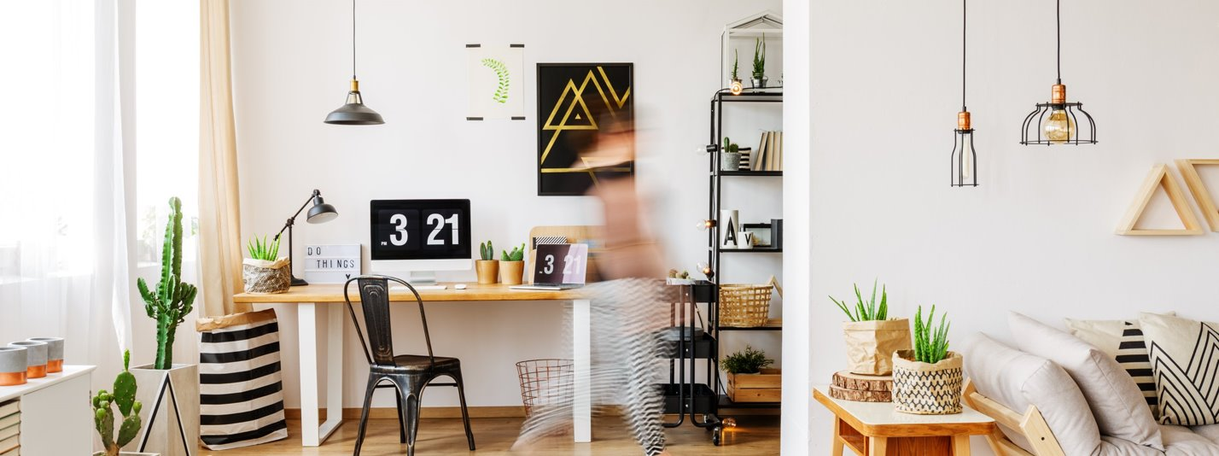
The homes we need
What makes a healthy home?

Slide 26
What makes a Healthy Home?
Information
Motivation
Ability to Act
Normalising
And really well-designed windows!!!
That allow for plenty of daylight, ventilation, user control and location both inside and outside.
‘Hyper localised Architecture’
Ann Vanner FCIAT, LFA, ARB, RIBA, FRSA

Slide 27
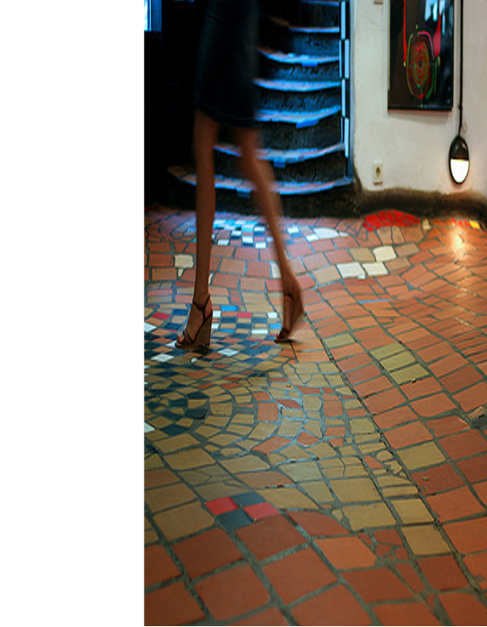
We need to design for our senses
We have disconnected ourselves from the natural world and we ignore the signs.
The memory of a bakery or a chippy is a memory that most can recall from our childhood. It's unlikely to be due to the visual features of the shop.
Multi-sensory design approach that recognises and cater for all senses.
This needs a proactive and sensual approach as a design process we are all part of rather than being seen as an engineering problem to try and resolve.
Ann Vanner FCIAT, LFA, ARB, RIBA, FRSA

Slide 28
Air Quality ‘Air Health’
Actions – (We are not going to look at thermal comfort, lighting and acoustic)
Breathe easy - open a window (especially before going to bed)
Let air in - oxygenate the air and remove CO2
Spring clean your indoor air quality
Regulate humidity - don’t let it get above 49%
Let daylight in
Viral load in rooms - not just Covid19, but also other air borne viruses
Watch the smell
Avoid the ‘greenwash’ and unregulated language
Ann Vanner FCIAT, LFA, ARB, RIBA, FRSA

Slide 29
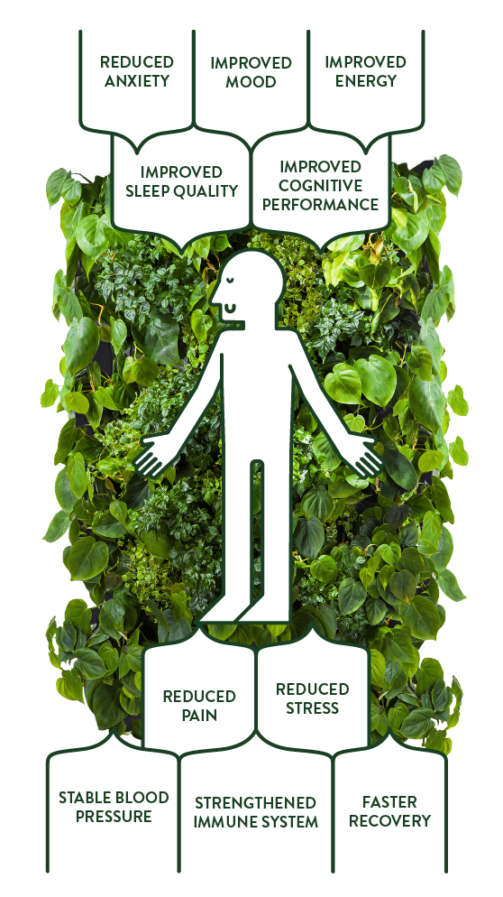
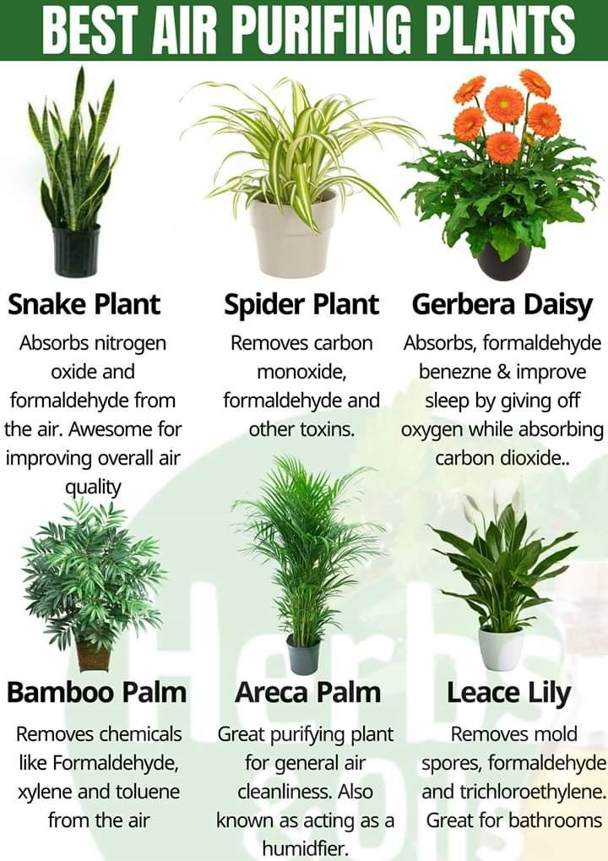
The Joy of Plants
‘Quietly breathing out the oxygen you are breathing in’.
Having more green round us has a positive effect on ourselves and our environments.
A green space has a positive impact on out mental health.
The idea of Vitamin N
NASA's Clean Air Study found that there are a number of air purifying plants that can detoxify your home from the airborne toxins, dusts and germs that can be found in a variety of household products, materials and furniture.
The right air purifying plants can help detoxify the air in your living spaces, meaning your houseplants not only look lovely but work a little harder to clean the air you breathe in.
Ann Vanner FCIAT, LFA, ARB, RIBA, FRSA

Slide 30
Biophilia
‘The urge to affiliate with other forms of life’ Edward O Wilson.
suggests that humans possess an innate tendency to seek connections with nature and other forms of life
We are part of nature, but we have now become disconnected.
‘Be aware of nature’…. Should be ‘Be aware of the city!
A series of principles based around three categories.
Nature in the space
Natural Analogues
Nature of the space.
Ann Vanner FCIAT, LFA, ARB, RIBA, FRSA

Slide 31
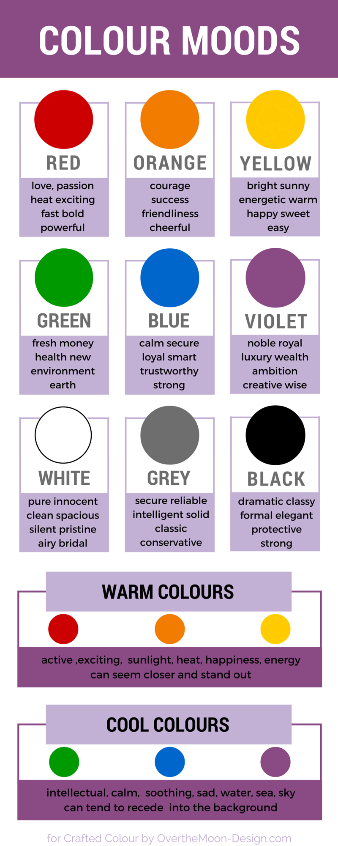
Other measures (these are for another talk!)
Just as many animals build nests, humans also like to be actively engaged in the design and creation of the living environments
SPATIAL THEORY – The impact space has at an emotional, mental and spiritual level
COLOURS- ‘Green sets the scene’…. But watch the paint!
LOOK and FEEL OF THINGS
ACTIVE AND INCLUSIVE DESIGN
AMENITIES
THE IMPORTNACE OF COMMUNIITES
Ann Vanner FCIAT, LFA, ARB, RIBA, FRSA

Slide 32
At the beginning of the talk I said one of my mantras is ‘Learning from the everyday to ensure the everyday is well designed’
Architecture
is not the
prerogative of a few nor the privilege of an elite;
it is for all, and by all
I hope I haven’t scared you too much
That you have a greater understanding of, how to keep heat in, the issues of Indoor Air Quality and know what Biophilia is and will look up Hundertwasser

Slide 33
Last few slides
If anyone wants to continue this conversation or has any questions that they want to ask in person then here are my contact details
LinkedIn https://www.linkedin.com/in/ann-vanner/
Website www.ann-vanner.co.uk
Email ann@studio-perfectus.co.uk

Slide 34
Thank you (and breathe) Any questions?
Ann Vanner FCIAT, LFA, ARB, RIBA, FRSA ​

